Slide 1

Relational Design Theory
Functional Dependencies

Slide 2
Functional Dependencies
Relational design by decomposition
“Mega” relations + properties of the data
System decomposes based on properties
Final set of relations satisfies normal form
No anomalies, no lost information
Functional dependencies ⇒ Boyce-Codd Normal Form
Multivalued dependences ⇒ Fourth Normal Form
Functional dependencies are generally useful concept
Data storage – compression
Reasoning about queries – optimization
Notes:
Next set of slides cover functional dependencies. First a quick recap of relational design by decomposition. The idea is that the application designer writes mega relations that contain all the information that we want to have and properties of the data that we're storing. And then the system will automatically decompose those based on the properties that are specified. The final set of decomposed relations will satisfy what's called the normal form, and normal forms are good relations in the sense that they have no anomalies and they don't lose information from what was specified in the original mega relations. Now the properties themselves are defined as functional dependencies in which case the system will generate Boyce-Codd Normal Form relations.
And let me say that functional dependencies are actually a generally useful concept in databases not only for relational design. Functional dependencies, as we'll see soon, are a generalization of the notion of keys and they allow the system to, for example, store the data more efficiently. Compression schemes can be used based on functional dependencies for storage, and also functional dependencies, as a generalization of keys, can be used to reason about queries and for query optimization.

Slide 3
Functional Dependencies
Example: University application info.
Student(CNIC, sName, address,
HScode, HSname, HScity, GPA, priority)
Apply(CNIC, uName, city, date, major)
Notes:
As always we'll be using as a sample a university application database and in this case I've expanded the information that we're including quite a bit. We'll be using these same two relations as examples throughout this lecture and subsequent lectures on relational design. In this case we're gonna look at two relations, one with information about students and then a separate one with information about where they're applying. The student information will have CNIC, the student's name, their address and then three attributes about their high school. We'll assume there are unique codes for high schools, but they also have a name and are in a city, finally the student's GPA, and a priority field for admissions that we'll see in a moment. For applications, we'll have the student's CNIC number, the university name they're applying to, the city of the university, the date of application and the major.

Slide 4
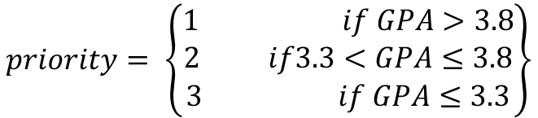
Functional Dependencies
Student(CNIC, sName, address,
HScode, HSname, HScity, GPA, priority)
Suppose priority is determined by GPA
Two tuples with same GPA have same priority
$$priority= \left\{\begin{aligned}1 if GPA>3.8 \\ 2 if3.3<GPA≤3.8 \\ 3 if GPA≤3.3\end{aligned}\right\}$$
Notes:
To motivate functional dependencies, let's focus on the student relation and specifically on the GPA and priority attributes. Let's suppose that a student's priority is determined by their GPA. For example, we might have a rule that says if GPA is 3.8, greater than 3.8 then priority is 1. If the GPA is say, in between, let's say, 3.3 and 3.8. Then we'll set priority to be equal 2, and let's say if the GPA, then, is less than 3.3, then the priority value is three. So, if this relationship is guaranteed in our data then what we can say is that any two tuples that have the same priority are guaranteed to have the same GPA.

Slide 5
Functional Dependencies
Student(CNIC, sName, address,
HScode, HSname, HScity, GPA, priority)
Two tuples with same GPA have same priority
GPA → Priority
∀ t,u ∈ Student:
if t.GPA = u.GPA then t.priority = u.priority
In general, A → B
∀ t,u ∈ R:
if t.A = u.A then t.B = u.B
Notes:
And let's formalize that concept. So I'm going to write a little logical statement here to formalize the concept. I'm going to use the for all symbol (∀) from predicate logic and I'm going to say for all t, u, and those are tuples in the student relation, if the students t and u have the same GPA then they have the same priorities. So this logical statement is in fact a definition of a functional dependency, and we would write that functional dependency as GPA arrow priority, so that says the GPA determines the priority, any 2 tuples with the same GPA must have the same priority.
So that was a specific example. Now let's generalize our definition. So, let me replace GPA and priority here with just two attributes A and B of say a relation R. And then we'll also need to modify our definition.
Actually I'm gonna generalize this definition even further because functional dependencies don't always have to have one attribute on each side, they can actually have a set of attributes e.g. A1,A2,A3,…An -> B1,B2,B3….Bn
For simplicity I'm going to often abbreviate a list of attributes or set of attributes by using a bar. So I'll write Ᾱ to indicate a set of attributes. And again, this is just for convenience.

Slide 6
Functional Dependencies
Functional Dependency
Based on knowledge of real world
All instances of relation must adhere
R(A,B,C) has functional dependency A → B
A | B | C
a | b | c₁
a | b | c₂
A | B | C
a | b | c₁
a | b | c₂
aa | bb | c₃
a | b | c₄
aa | bb | c₅
Current Instance
Future Instance
Notes:
A functional dependency for a relation is based on knowledge of the real world data that's being captured. And when we specify one, all instances of the relation must adhere to the functional dependency i.e. every instance of our relation must satisfy the condition that if the A values are the same, then the B values are also the same.

Slide 7
Functional Dependencies
Student(CNIC, sName, address,
HScode, HSname, HScity, GPA, priority)
Functional Dependencies:
CNIC → sName
CNIC → address
HSCode → HSname, HScity
HSname, HScity → HSCode
CNIC → GPA
GPA → priority
CNIC → priority
Notes:
Finally, let's come back to our example. I think when we start writing functional dependencies for our actual relations it'll give you a good idea of what they're really capturing. So let's write a few functional dependencies for our student relation based on what we expect to be true in the real world in the data that we're capturing in the relation. So here's a first example, CNIC number functionally determines sname, the student's name. This means to say if we have multiple tuples about a particular student and these tuples have the same CNIC number, each of the tuples would have the same name too. And presumably because 123 is sort of identifying the student that would be a natural functional dependency that would hold in this case and similarly we would expect CNIC to determine address, although we're already making an assumption about the real world here, if we have this particular functional dependency, then we're saying a student doesn't move. They don't have multiple addresses. Every tuple that describes that student by their CNIC number will have the same address. Let's go to the high school and see what might be going on there. Every time we have the particular high school code, maybe for different students, it would have the same name and also it would have the same city. So that's an example of a functional dependency with two attributes on the right hand side. Now, let's look at one that's a little more complicated, which is one that has two attributes on the left hand side instead. That actually turns out to be a more interesting case. In fact, in this particular case, we can probably reverse the arrow and have a functional dependency in the other direction. If we have a combination of high school name and high school city, I'm going to assume that's unique, that there's never two high schools with the same name in the same city. And if that's the case, if that's unique, then we would expect a functional dependency to the high school code. Any time we have the same name and city, we're talking about the same high school so we should have the same code. What other examples do we have? If we assume that there's one GPA for each student then we'd have the CNIC number determines the GPA and we already talked about GPA determines priority and actually if we put these two together we should see well if we have the same CNIC number twice we should have the same priority. That's kind of a transitive rule and it takes these two (CNIC → GPA , GPA →priority) and produces that one (CNIC → priority). And we'll talk about rules for functional dependencies later. And there may be more in this case.

Slide 8
Functional Dependencies
Apply(CNIC, uName, city, date, major)
Functional Dependencies:
CNIC , uName → major (Assuming that students are only allowed to apply to a single major at each university )
Notes:
Now let's take a look at functional dependencies for our apply relation. Actually, this one is a little trickier, it's even possible there are no functional dependencies at all. It really depends on the real world data, the real world constraints. One possibility for example might be that students are only allowed to apply to a single major at each university they apply to. That seems rather unlikely, but I was struggling to find functional dependencies for this case. So if that were the case, this is another one with two attributes on the left hand side, we'd say that the CNIC number, together with the university, implies the major. In other words, we cannot have a student and university combination with two different majors and that captured that constraint. For the apply relation specifically, again, it's really the real world constraints that drive which functional dependencies hold for the relation. But it's important to understand those constraints so they can be translated to functional dependencies, which then can drive a good relational design.

Slide 9
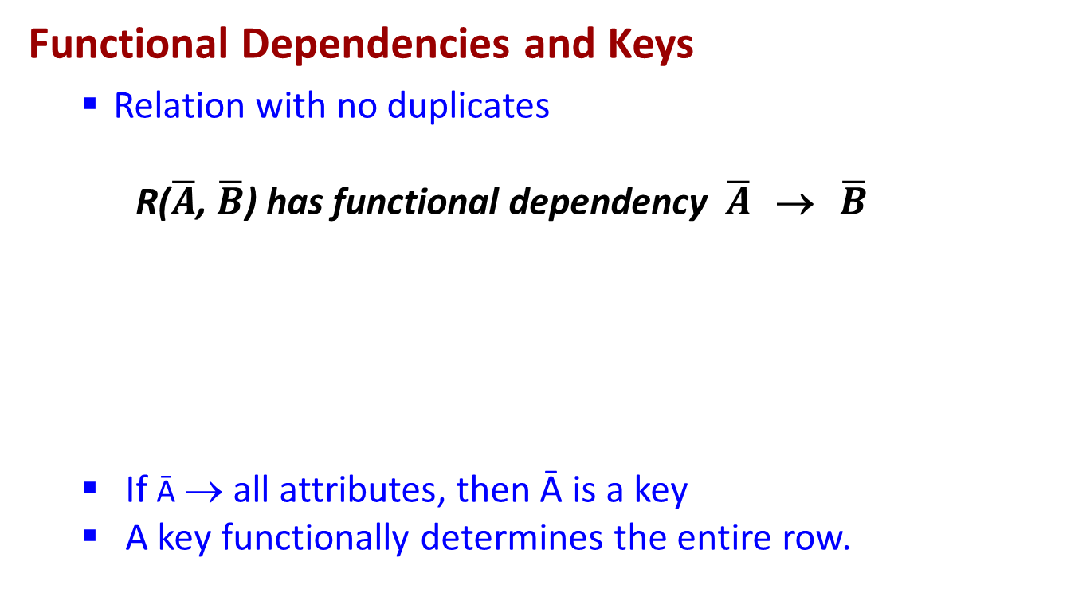
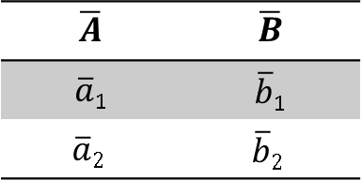
Functional Dependencies
Functional Dependencies and Keys
Relation with no duplicates
R($\overline{A}$, $\overline{B}$) has functional dependency $\overline{A}$ → $\overline{B}$
If Ᾱ → all attributes, then Ᾱ is a key
A key functionally determines the entire row.
$$\overline{A}$$ | $$\overline{B}$$
$\overline{a}$₁ | $\overline{b}$₁
$$\overline{a}2$$ | $$\overline{b}2$$
Notes:
I've alluded a few times to the fact that functional dependencies generalize the notion of keys. And let's make that connection explicit now. Let's suppose we have a relation R and it has no duplicate tuples. R has some attributes Ᾱ and it has some other attributes $\overline{ B}$. And let's suppose that we have a functional dependency that Ᾱ determines all of the attributes in the relation. If we have no duplicates in a relation, a set of attributes, that can functionally determine all the other attributes, is a key. In above relations, since Ᾱ functionally determines all attributes, Ᾱ is a key.

Slide 10
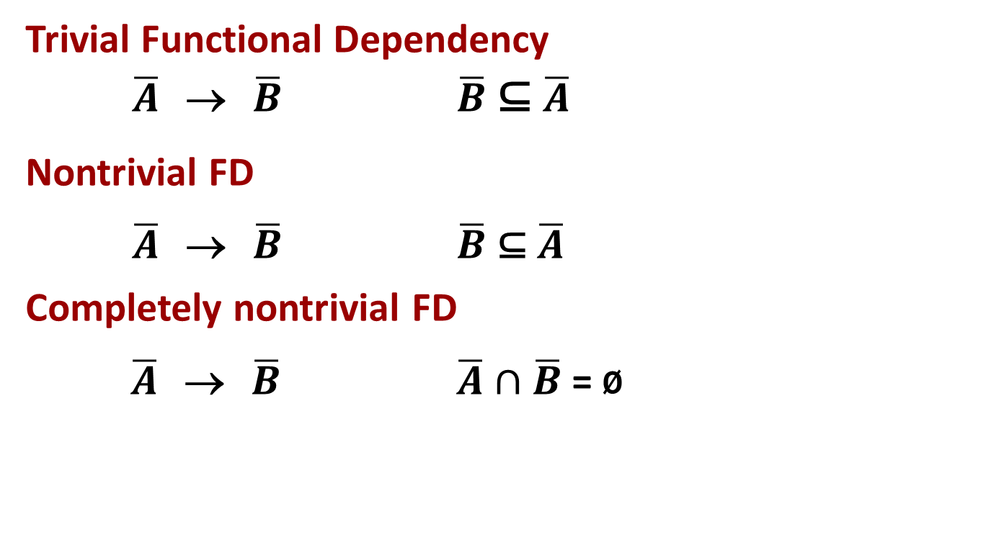
Functional Dependencies
Trivial Functional Dependency
$\overline{A}$ → $\overline{B}$ $\overline{B}$ ⊆ $\overline{A}$
Nontrivial FD
$\overline{A}$ → $\overline{B}$ $\overline{B}$ ⊆ $\overline{A}$
Completely nontrivial FD
$\overline{A}$ → $\overline{B}$ $\overline{A}∩$ $\overline{B}$ = ø
Notes:
So here are a few other definitions related to functional dependencies. We have a notion of a trivial functional dependency. A functional dependency $\overline{A}$ → $\overline{B}$ is trivial if $\overline{B}$ is a subset of $\overline{A}$. In student relation, the HSname, HScity → HSname is a trivial functional dependency. Well, it's pretty obvious that if two tuples have the same values across their entire expanse for HSname, HScity , then obviously they're also going to have the same values for just this portion here, the HSname portion. So that's why it's called the trivial functional dependency.
A nontrivial functional dependency is a functional dependency that's not a trivial one. By the way, FD is a common abbreviation for functional dependency. So if we have $\overline{A}$ → $\overline{B}$, then that is non-trivial if it's not the case that $\overline{B}$ is a subset of $\overline{A}$. In student relation, HSname, HScity → HSname , HScode is a non trivial FD. And now we're saying there are some attributes in $\overline{B}$ that are not part of $\overline{A}$.
And the last definition is a completely nontrivial functional dependency, and that's $\overline{A}$ → $\overline{B}$ where $\overline{A}$ and $\overline{B}$ have no intersection at all. In student relation, HSname, HScity → HScode is a completely non trivial FD. And the reality is that completely nontrivial functional dependencies are the ones that we're most interested in specifying.

Slide 11
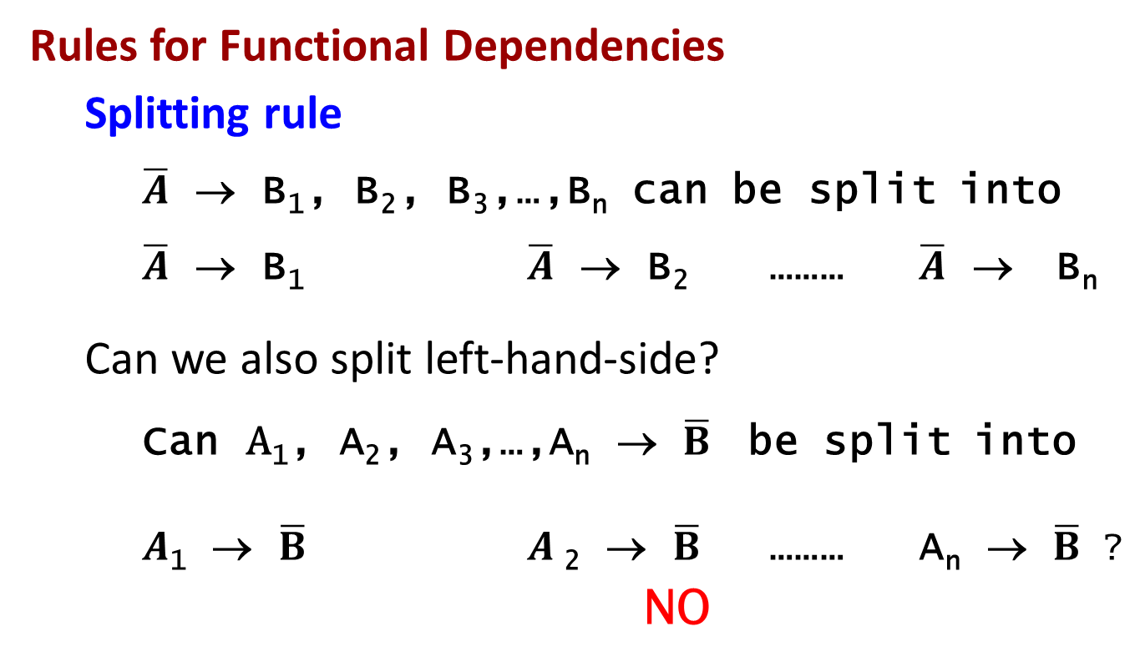
Functional Dependencies
Rules for Functional Dependencies
Splitting rule
$\overline{A}$ → B₁, B₂, B₃,…,B_{n} can be split into
$\overline{A}$ → B₁ $\overline{A}$ → B₂ ……… $\overline{A}$ → B_{n}
Can we also split left-hand-side?
Can $\text{A}\text{1}\text{, }\text{A}\text{2}\text{, }\text{A}\text{3}\text{,…,}\text{A}\text{n}$ → $\overline{B}$ be split into
$A$₁ → $\overline{B}$ $A$₂ → $\overline{B}$ ……… A_{n} → $\overline{B}$ ?
NO
Notes:
I mentioned that there are some rules that apply to all functional dependencies and I'll give a couple of those right now. The first one is the splitting rule. The splitting rules says that if we have a set of attributes that determine another set of attributes then we this implies that we have $\overline{A}$ determines B₁ and $\overline{A}$ determines B₂ and so on. In other words, we can split the right side of the functional dependency. If we say that ”when the $\overline{A}$ value are the same all of the B values have to be the same “then certainly when the $\overline{A}$ values are the same the B values have to be the same independently. In student relation, the functional dependency HScode → HSname , Hscity can be split into HScode → HSname and HScode → Hscity.
Now you might wonder if the splitting rule also goes the other way. So let's say we have, we have A₁ through A_{n} determines $\overline{B}$ then IS IT the case that A₁ determines $\overline{B}$ and A₂ determines $\overline{B}$ on its own, and so on? Well, the answer to that is no. And I'll give a simple example from our university application database. So let's say that we have the functional dependency HSname, HScity → HScode . We talked about that one before. So that says that when we have a particular name and city combination for a high school, that's identifying a single high school, and so it will always have the same code. So that makes a lot of sense but it is not the case if we split the left hand side that high school name alone will determine a high school code. So for example, I would venture to guess that there are a lot of Roots Schools all over the country and they won't all will be the same high school. So it's really the combination of attributes on the left that together functionally determine the right hand side and so we do not then have the splitting rule as a general principle.

Slide 12
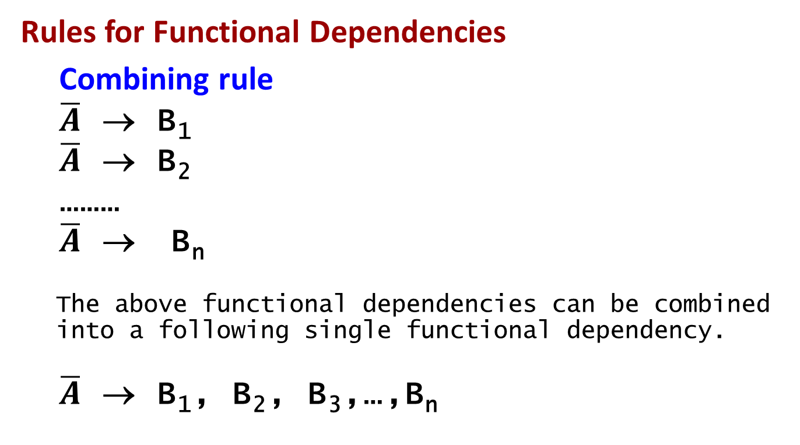
Functional Dependencies
Rules for Functional Dependencies
Combining rule
$\overline{A}$ → B₁
$\overline{A}$ → B₂
………
$\overline{A}$ → B_{n}
The above functional dependencies can be combined into a following single functional dependency.
$\overline{A}$ → B₁, B₂, B₃,…,B_{n}
Notes:
The combining rule is the inverse of the splitting rule.

Slide 13
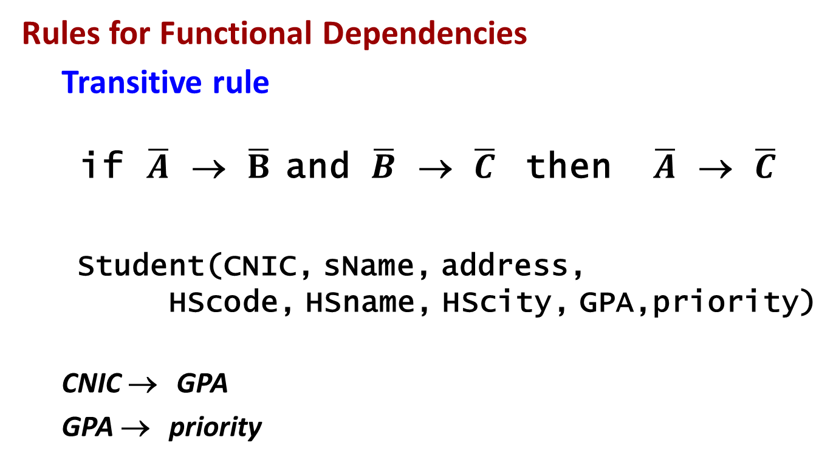
Functional Dependencies
Rules for Functional Dependencies
Transitive rule
if $\overline{A}$ → $\overline{B}$ and $\overline{B}$ → $\overline{C}$ then $\overline{A}$ → $\overline{C}$
Student(CNIC, sName, address,
HScode, HSname, HScity, GPA,priority)
CNIC → GPA
GPA → priority
CNIC → priority
Notes:
And finally the transitive rule, which is the one we alluded to earlier. It says if we have $\overline{A}$ determines $\overline{B}$ and we have $\overline{B}$ determines $\overline{C}$, then we have $\overline{A}$ determines $\overline{C}$.

Slide 14
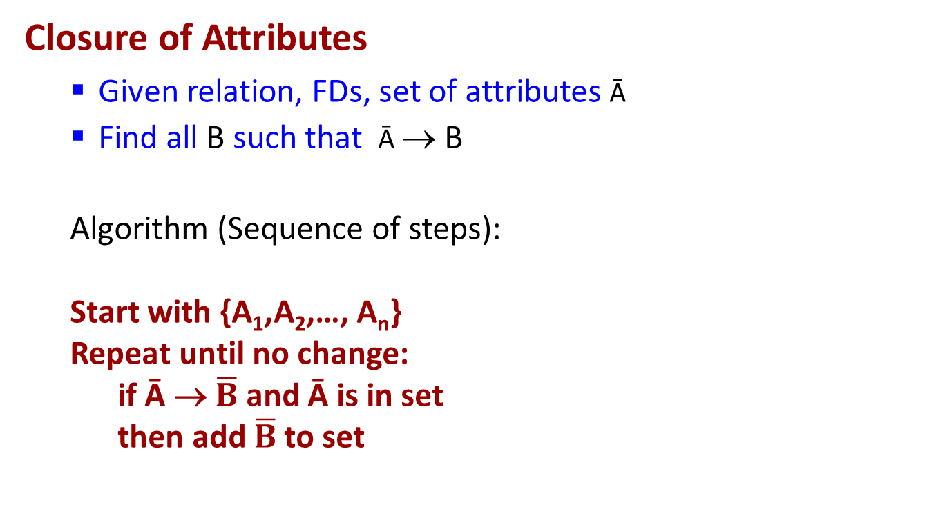
Functional Dependencies
Closure of Attributes
Given relation, FDs, set of attributes Ᾱ
Find all B such that Ᾱ → B
Algorithm (Sequence of steps):
Start with {A₁,A₂,…, A_{n}}
Repeat until no change:
if Ᾱ → $\overline{B}$ and Ᾱ is in set
then add $\overline{B}$to set
Notes:
Now, I'm going to introduce the concept of closure of attributes. Let's suppose we're given a relation, a set of functional dependencies for that relation, and then a set of attributes Ᾱ that are part of that relation. I'm interested in finding all attributes B of the relation such that Ᾱ functionally determines B. And this is what's called the closure, and I'll show in a bit why we might want to compute that. Notationally the closure is written using the + sign i.e. Ᾱ⁺. And I'm going to give an algorithm for doing that. My algorithm says start with the set itself. So I'm going to start with A₁ through A_{n} (Since Ᾱ functionally determines A₁ through A_{n}, a trivial dependency). And then I'm going to repeat the following over FD’s until there's no change. If Ᾱ determines $\overline{B}$ and all of Ᾱ are in the set, then add $\overline{B}$ to the set. And when there's no more change, then I've computed the complete closure. Now if you happen to be someone who likes to think in terms of rules instead, what we're effectively doing is applying the combining and transitive rules to the attributes in the set until there's no change.

Slide 15
Functional Dependencies
Closure Example
Student(CNIC, sName, address,
HScode, HSname, HScity, GPA, priority)
CNIC → sName, address, GPA
GPA → priority
HScode → HSname, Hscity
Ᾱ = {CNIC, HScode}
Ᾱ⁺ = {CNIC, HScode} (At the start)
Ᾱ⁺ = {CNIC, HScode, sName, address,GPA} (After 1st FD)
Ᾱ⁺ = {CNIC, HScode, sName, address,GPA,priority} (After 2nd FD)
Ᾱ⁺ = {CNIC, HScode , sName, address,GPA, priority, HSname, HScity} (After 3rd FD)
Notes:
So let's run an example of the closure algorithm. Let's go to our complete student table and let's add three functional dependencies. One that says that student's CNICnumber determines their name, address and GPA and that would be a normal... GPA determines priority, and high school code determines high school name and high school city. Again, these are all examples we gave earlier that would be natural functional dependencies for this particular relation. Let's suppose that we're interested in computing the closure of the two attributes - CNIC number and high school code. So in other words, we want to find all attributes in the student relation that are functionally determined by these two attributes. So the algorithm says start with the two attributes themselves, CNIC number and high school code, and then add attributes that are functionally determined by ones in the set. So if we start with our first functional dependency here, because we have CNIC number, that allows us to add the student name, the address, the GPA... and that's it for that one. Now let's repeat again. Because we have the GPA, our second functional dependency tells us we can add the priority. And that's it for that one. And then since we have the high school code in this set, our third one tells us that we can add the high school name and the high school city and at that point we certainly know we're done because we've actually got the entire relation at this point. Now I didn't pick this particular example at random. We took two attributes, CNIC number and high school code, we computed their closure, and we discovered that they together functionally determine all attributes of the student relation.

Slide 16
Functional Dependencies
Closure and Keys
Is Ᾱ a key for R ?
Compute Ᾱ⁺ .
If Ᾱ⁺ contains all the attributes of relation R
Then Ᾱ is a key.
How can we find all keys given a set of FDs?
Use the above procedure for every subset of attributes in increasing subset size order.
Notes:
Now remember just a few slides ago, when a set of attributes functionally determine all the attributes, then those attributes together form a key for the relation. And in fact if you think about it, CNIC number and high school code together are a natural key for the relation. A student might go to multiple high schools, but there's no reason to have more than one tuple with the combination of a particular student and the high school they attended. So let's formalize a bit this relationship between the notion of closure and keys. Let's suppose we're interested in answering the question... is a particular set of attributes a key for a relation? We can use closure to do that. Remember, we have the relation, and we have a set of functional dependencies for the relation, so what we do is we compute the closure of A that's going to give us a set of attributes and if that equals all attributes, then A is the key. As a more general question, let's suppose we're given a set of functional dependencies for a relation, how can we use it to find all of the keys for the relation? So use the same basic idea of computing closure, but this time we have to do it for every subset of the attributes. And by considering every subset of the attributes in R, then we're considering every possible key and we'll just check for each one whether it's actually a key. Now that seems fairly inefficient and actually we can be a little more efficient than that. We can consider these subsets in increasing size order. So for example, if we determine that attributes A and B together determine all attributes functionally determine all attributes in the relation. That tells us A,B is a key, and that actually also tells us that every SUPERSET of A,B is also a key. So the real algorithm would say let's start with single attributes and determine if they are key. If a single attribute say C, is a key then so is every super set of C, and then we go to pairs of attributes and so on.

Slide 17
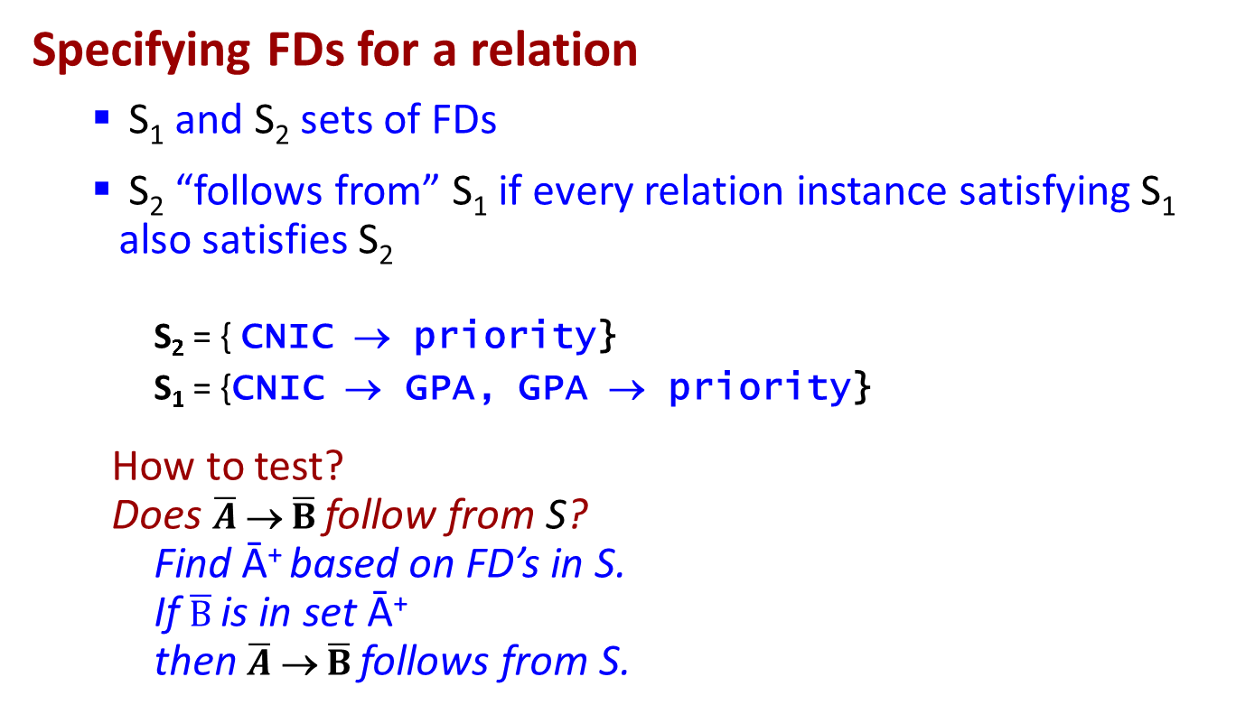
Functional Dependencies
Specifying FDs for a relation
S₁ and S₂ sets of FDs
S₂ “follows from” S₁ if every relation instance satisfying S₁ also satisfies S₂
S₂ = { CNIC → priority}
S₁ = {CNIC → GPA, GPA → priority}
How to test?
Does $\overline{A}$ → $\overline{B}$follow from S?
Find Ᾱ⁺ based on FD’s in S.
If $\overline{B}$is in set Ᾱ⁺
then $\overline{A}$ → $\overline{B}$follows from S.
Notes:
Finally let's talk about how we specify the set of functional dependencies for a relation. First I'll define a notion of “one set of functional dependencies following from another one”. So let's suppose we have a relation R and we have two sets of functional dependencies that aren't identical, S1 and S2. We see that S2 follows from S1 if every relation instance satisfying S1 also satisfies S2. As a simple example, suppose S2 is CNIC number determines priority, and suppose S2 is the two functional dependencies – CNIC number determines GPA, and GPA determines priority. Then it's certainly the case that for this example that S2 follows from S1. Every time we have a relation that satisfies CNIC number determines GPA and GPA determines priority, then that relation will also satisfy CNIC number determines priority and we kind of proved that actually in an earlier part of this lecture.
So one question you might have is how do we test whether one set of functional dependencies follows from another. That really boils down to testing whether one functional dependency follows from a set. If we have S1 and S2, then we just check whether every functional dependency in S2 follows from the functional dependencies in S1.
To test this, one of the ways is to use the closure. We'll compute Ᾱ⁺ based on the functional dependencies that are in S and then we'll check if $\overline{B}$ is in the set. Reminder - computing the closure tells us every attribute that's functionally determined by the attributes in $\overline{A}$ based on the functional dependencies in S. If those include $\overline{B}$, then $\overline{A}$ → $\overline{B}$ does indeed follow from S.
For the case S₂ = { CNIC → priority}
S₁ = {CNIC → GPA, GPA → priority}
If we want to test whether S2 follows from S1, we need to use the above mentioned procedure for every FD present in S2, which in our case is only one i.e. CNIC → priority.
A = {CNIC}
A⁺ at start = {CNIC}
A⁺ after processing the 1st FD in S1= { CNIC, GPA}
A⁺ after processing the 2nd FD in S1= { CNIC, GPA, priority}
Since B = {priority} is in set A^{+,} we can say that CNIC → priority follows from S.

Slide 18
Functional Dependencies
Specifying FDs for a relation
Want: Minimal set of completely nontrivial FDs such that all FDs that hold on the relation follow from the dependencies in this set
Notes:
So you might wonder why did I introduce this notion of one set of functional dependencies following from another and for that matter, why did I introduce trivial and non-trivial functional dependencies. Well, I'm going to sum up in one sentence what we're looking for when we specify the set of functional dependencies for a relation. So we have a notion of the real world data, we have our attributes but we need to specify the functional dependencies in order to get a good design. What we would like to find is a minimal set, S, of completely non-trivial functional dependencies such that all functional dependencies that hold on the relation follow from the dependencies in this set, S. Wow, that seems like some very complicated thing, but the fact is when you start specifying functional dependencies, you'll discover that you will actually get this definition pretty naturally.

Slide 19
Functional Dependencies
Functional dependencies are generally useful concept
Relational design by decomposition
Functional dependencies ⇒ Boyce-Codd Normal Form
Data storage – compression
Reasoning about queries – optimization
Notes:
So to conclude, functional dependencies are a generally useful concept in database systems. They 're a key ingredient of doing relational design by decomposition, because we use the functional dependencies to get Boyce-Codd Normal Form which is what we'll cover in the next lecture, but they're also useful for the system to determine how to store data, to compress data and also to reason about query processing.

